Slide 1
The Effects of Adherence of a Soul Food Diet for African Americans with Osteoarthritis
Alyssa Ton, Adrian Simpson, Audray Rong

Slide 2
Clinical Trial Outline
Background
Population Criteria, Intervention, and Control
Recruitment and Assessments
1
3
5
2
4
6
Research Study Question
Outcome Measures
Statistical Analyses and Expected Challenges

Slide 3
Background: What is Osteoarthritis?
OA cannot be reversed but reduced w/ lifestyle adjustments and preventative measures
Osteoarthritis (OA) : most common form of arthritis and occurs when protective cartilage cushioning the ends of bones wear down over time, most commonly as a result of aging ¹
Symptoms:
Inflammation
Joint pain
Stiffness
Overall hindrance of ease of daily activities

Slide 4
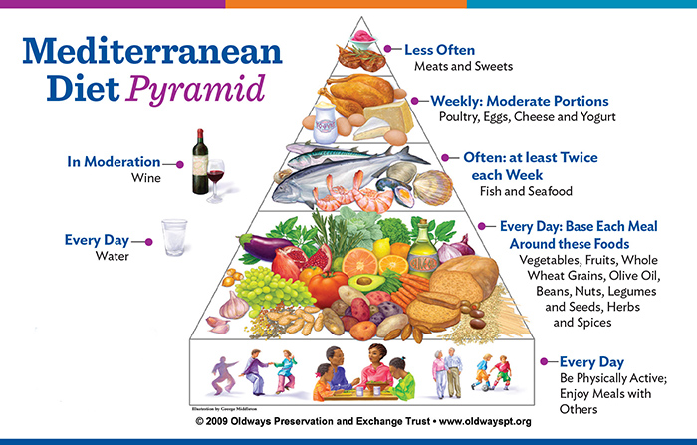
Current Treatment = The Ultimate Arthritis Diet ?
The Arthritis Foundation, lists the Mediterranean diet as ‘The Ultimate Arthritis Diet’ to combat inflammation symptoms ^{2,3}
Fruits
Vegetables
Whole grains
Legumes
Healthy fats (olive oil, nuts)
Moderate amounts of seafood
Low dairy and red meat
Insert your content
Notes:
https://nutrition.org/living-mediterranean-lifestyle/

Slide 5
The OA Funnel
OA is one of the most financially burdensome conditions for privately insured patients in the US, over $6.3 billion in health expenses
$$$
Increasingly aging and diverse population ⁴
OA affect Black Americans more than whites
Black patients tend to have higher severity of pain and disability as a result but less likely to seek/obtain care and treatment
Very little information on racial disparities
of OA in US
Ultimate Arthritis Diet
Euro-centric diet as a gold standard
Stigmatization ⁵
Does not mirror diverse populations affected and need treatment for OA
Exacerbates the need for culturally inclusive/competent care

Slide 6
Research Question
Does a culturally sensitive diet, soul food, help African Americans with osteoarthritis improve/increase diet adherence in comparison with the current American standard diet, the Mediterranean diet?
Soul Food: ‘ethnic cuisine traditionally prepared and eaten by African Americans’ ⁶
Beans, greens, cornmeal, fisk, pork, kale and collards, black eyed peas
Principles of the Mediterranean diet (dark leafy greens, legumes) can be integrated into soul food diet while still being culturally inclusive for the hope of a better health outcome and adherence
Notes:
https://www.delish.com/food-news/a26356466/what-is-soul-food/

Slide 7
Study Population and Eligibility Criteria
Inclusion | Exclusion
Self- identifying as black 40 - 65 years of age Diagnosed with OA Sedentary lifestyle (<30 min p/week of formal exercise for the past 6 months) Being able to eat by mouth Having no risks of choking Able to understand English or Spanish language Ability to sign a written consent themselves | Specific restricted diet Allergic/intolerant or avoids specific foods that will be in the meal plan Has another form of bone-degenerative disease Already follows a strict meal plan (due to disease) Unable to prepare their own foods Cannot eat food by mouth Unable to understand English or Spanish language

Slide 8
Intervention
Control
100%
Soul food
Mediterranean Diet

Slide 9
Outcomes
Primary Outcome: Adherence
Adherence was selected as the primary outcome to measure if a possibly familiar diet would have an effect in comparison to the standard of care diet..
Adherence would be measured on multiple levels: daily, bi weekly, and monthly.
Daily: Self-Report of daily meals and snacks eaten.
Bi Weekly: Physical Check-Up and Report by an Investigator
Monthly: Required Doctoral Visit
Secondary Outcome: Inflammation
Inflammation was selected as the secondary outcome to measure the effects of an ‘adhered-to-diet’ in comparison with the standard of care diet.
Inflammation would be measured on multiple levels, bi weekly and monthly.
Daily: Self-Report of discomfort/comfort in Food-Journal.
Biweekly: Physical Checkup and Report by an Investigator.
Monthly: Required Doctoral Visit

Slide 10
Recruitment
Recruitment was done through four sites, that were either hospitals affiliated with a Historically Black College or University (HBCU) or determined to be within a location with a high population of African Americans.
The four Locations would be:
Emory University Hospital, Howard University Hospital, Johns Hopkins Hospital, and Detroit Medical Center
All participants had to meet the inclusion criteria to be a part of the study, and we aimed for 50% of our participants to identify as female.
Participants do not have to have an interest in soul food, but will be told that the diet will be inspired by Soul food.

Slide 11
Assessments
Level 1: Daily:
Adherence: food journal
Participants will be given a food journal in which they will report their daily eating habits and comfort/discomfort levels in relation to osteoarthritis. This solely relies on self-report.
Level 2: Bi-Weekly
Bi-Weekly Investigator Inflammatory Report Checkup
Participants will meet bi-weekly with a member of the team in order to aid with an at-home inflammatory test.
Level 3: Monthly:
Secondary monthly check up
Participants will meet monthly with their doctor for a physical check-up, and the results will be transferred to the investigating team.

Slide 12
Ethical Considerations
Some ethical considerations that the investigating team would have to keep in mind is that the study population is not only a minority population, but a population that has been previously exploited in research studies. It is important that within our study that we take increased care and caution when working with sensitive materials, subjects, and conversations and implore to work with the population and not on the population. As a team of POC women, we have taken every step to make sure that our participants are protected. We have no conflicts of interest to declare.
Some steps that we have taken are:
ID Numbers for all Participants.
Taking a risk-benefit analysis for the participants.
Going through human subjects protection training.
Having IRB Approved Consent Forms

Slide 13
Randomization
​​
A | A | . | . | . | B
A | A | . | . | . | B
A | B | . | . | . | B
A | B | . | . | . | B
B | A | . | . | . | A
B | A | . | . | . | A
B | B | . | . | . | A
B | B | . | . | . | A
1 | 2 | . | . | . | 70
Eligible Participants
Intervention Group
Soul Food
Control Group
Mediterranean Diet
Randomly Assigned
Block Size =8
Use randomly number to generate the total population.
A - intervention group B - Control Group
Notes:
Decrease imbalance, want large sample size - use randomization
With block size 8, we have 70 groups - with randomly selected from 1-70 to generate the final sample size
Expected original sample size is 120 per groups - 240 in total

Slide 14

Main Statistical Analyses - Primary Outcome
Primary Outcome - participants’ adherence (delivered meals / # ate meals)
Two sample t-test
Significance level: 0.05
Power: 0.9
Sample size:
Notes:
Want to test difference in two population.
No any linear relationship

Slide 15
Main Statistical Analyses - Secondary Outcome
Secondary Outcome - Inflammation Scores
Two sample t-test
Different µ with primary outcome
Primary outcome - mean of ratio
Secondary outcome - mean of inflammation

Slide 16
Expected Project Challenges
Participants might provide wrong information for the number of meals they eat
Participants may not enjoy the meals, potentially lowering motivation to continue
Lying in the appropriate food journal
Participants may alter meals
Might not keep up attending doctor visits and scheduling bi-weekly appointments with research team

Slide 17
Resources
Osteoarthritis. Mayo Clinic. https://www.mayoclinic.org/diseases-conditions/osteoarthritis/symptoms-causes/syc-20351925. Published June 16, 2021. Accessed October 18, 2022.
Paturel A. The ultimate arthritis diet: Arthritis foundation. The Ultimate Arthritis Diet | Arthritis Foundation. https://www.arthritis.org/health-wellness/healthy-living/nutrition/anti-inflammatory/the-ultimate-arthritis-diet. Accessed October 18, 2022.
Barrell A. Osteoarthritis diet: 8 foods to eat and 3 to avoid. Medical News Today. https://www.medicalnewstoday.com/articles/322603. Published January 28, 2020. Accessed October 18, 2022.
Bureau USC. Nation continues to age as it becomes more diverse. Census.gov. https://www.census.gov/newsroom/press-releases/2022/population-estimates-characteristics.html. Published July 18, 2022. Accessed October 18, 2022.
Byrne C. The problem with the Mediterranean diet we need to talk about. Healthline. https://www.healthline.com/nutrition/the-problem-with-the-mediterranean-diet-were-not-talking-about-enough. Published February 8, 2022. Accessed October 18, 2022.
Peartree M, LaLomia F. Do you know the difference between Soul Food and Southern food? Delish. https://www.delish.com/food-news/a26356466/what-is-soul-food/. Published June 1, 2022. Accessed November 8, 2022.

Slide 18
Thank you!
Questions?

